Slide 1
Situational Awareness Analytical Capabilities
Report Automation with SAreportR R Package
Sorie Dumbuya
Dr. Jie Feng
Meeyoung Park
Thursday, October 06, 2022

Slide 2
Agenda
Purpose
Overview of current report generation process
Describe SAreportR package
Introduction
Key components
Demonstration
Discuss considerations (challenges, implications on current workflow, etc.)

Slide 3
Purpose

Slide 4
Purpose
Improvement
Intro to PoC
Where we are, what we’ve done
Benefits

Slide 5
Where we are now

Slide 6
Current Report Generation Process
Multiple teams reporting directly to the Director
Different teams using different software to generate different reporting products (graphs, tables, slides, etc.)
Products distributed or retrieved via email or SharePoint to be manually placed in reports

Slide 7
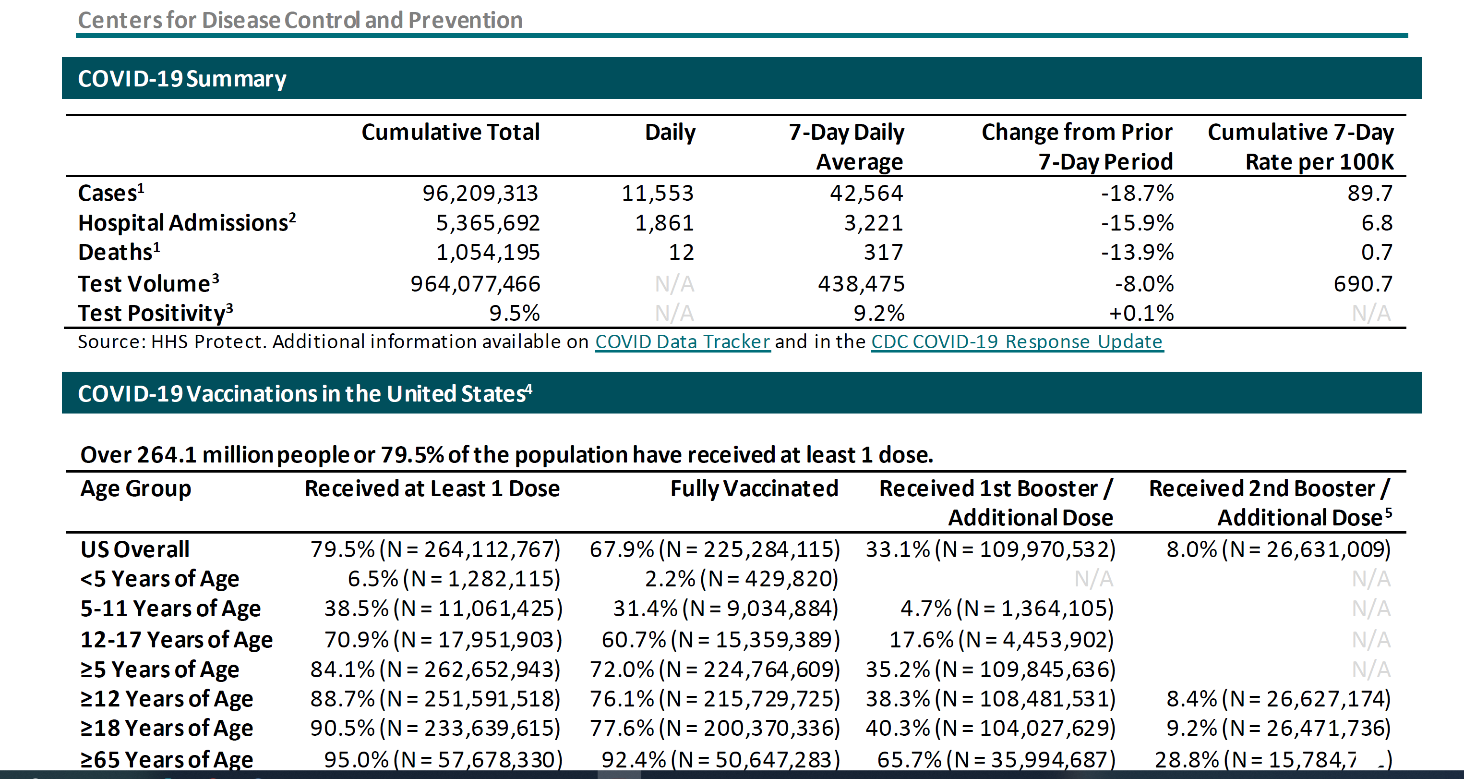
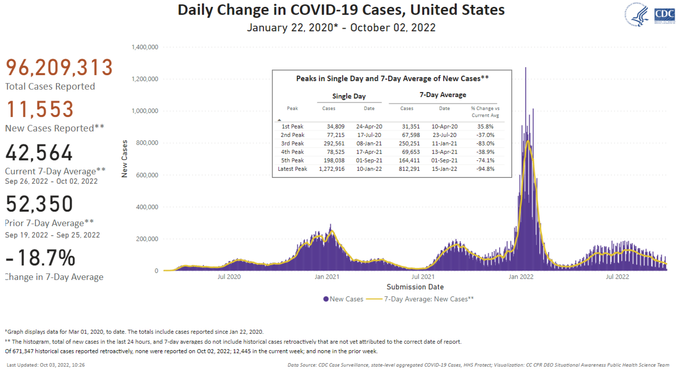
Example: Director’s Executive Summary
Generated in Excel by SA
Copy & pasted into Word template
Tables
Generated in Power BI by SA
Figures
Screen shot
Inserted in Word template
Received from Task Force

Slide 8
SAreportR

Slide 9
SAreportR
An SA-developed an automated capability (R package)
Serves as an app to automatically generate several types of response-related documents in various output formats
Provides a graphical user interface (GUI) for end-users to specify criteria before generating documents

Slide 10
Demonstration
The key tools used to implement this workflow are:
R / Python
Quarto / Rmarkdown
R Shiny
Other technologies working under the hood include:
C++
JavaScript
HTML/CSS
LaTeX

Slide 11
Dashboard
Developed with R Shiny
Allows users to:
select which documents to generate
select the parameters of each document

Slide 12
Templates
Developed with Quarto or RMarkdown
Components
Code Chunks
Parameters

Slide 13
Functions
Main Functions
included Templates
used to process data sets, create plots, format and output tables, etc.
Utility Functions
included within main functions
used to format columns, add calculated columns, scale plots, etc.

Slide 14
Documentation
Function documentation
Can be accessed two ways
within the IDE (RStudio)
via pkgdown site
Document SOPs

Slide 15
Demonstration

Slide 16
Recommendations

Slide 17
Recommendations
Report Compilation
Software Development Life Cycle
Implementing new features
Fixing bugs
Improving performance
Unit testing
And so on…
Git
On prem instance of Git on EDAV / CDCReady
OneDrive / SharePoint
R / Python Packages
Visualizations
Screen shotting, emailing, copying & pasting products
Power BI
Excel
Word and PPT templates
ggplot, highcharteR, plotly, etc.
Tables
flextable, gt, reactable, formattable, etc.

Slide 18
Benefits

Slide 19
Benefits
Reduce burden
Standardization
Improve speed and accuracy of analytic products
Repository of response-ready packages for reuse

Slide 20
Future Applications

Slide 21
Application for future use

